Slide 1
Distribution of Disease Casualties across USA in 2023
RU DATA SCIENCE PROJECT 3 Group members: Steven Schiffner, Medha Mallampati, Anna Lewis, Darshan Patel

Slide 2
Goal
For this project, our group wanted to show the death count of certain diseases in the United States in the year 2023, using an interactive map. The causes of death we wanted to show are:
Natural causes
Septicemia
Malignant neoplasms
Diabetes
Alzheimer’s disease
Flu and pneumonia
Chronic lower respiratory diseases
Other respiratory diseases
Nephritis, nephrotic syndrome and nephrosis
Heart disease
Cerebrovascular disease
COVID-19 (multiple causes)
COVID-19
Notes:
AL

Slide 3
Questions We Want to Answer
How prevalent are certain diseases in each state and over time?
For each disease, which ten states had the highest death count per 100k people?
Does a certain month have more or less deaths due to a certain disease?
Notes:
DP

Slide 4
Data Source
Our group got our data from the Center of Disease Control.
For the year 2023, the data is only available from January to August
Original DataFrame Count: 10476 rows, 35 columns
After Cleaning and Filtering: 1998 rows, 17 columns
Notes:
MM

Slide 5

Data Discussion - Ethics
We believe that we used this data ethically because this was a public data source, and the confidentiality of the patients was preserved. The data was from the Center of Disease Control (CDC), and any identifying information about patients was removed. The CDC allows for anybody to use their provided data at no cost or without restrictions.
Notes:
AL

Slide 6
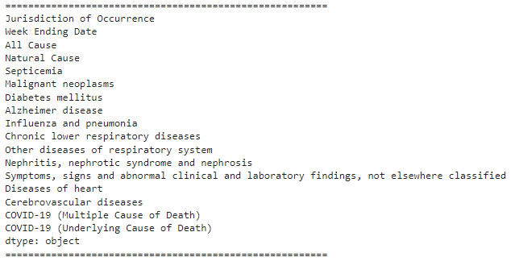

Slide 7
Code Discussion
Chloropleth map - made using Leaflet. We found a GeoJSON file based off US census data that contained borders for each US state (and Puerto Rico), and then augmented it with our CDC data. The map includes a continuous color scale as well as an info box that is displayed when you hover over the state.
Bar graph - To generate the bar graph, we used D3 to load our CSV of disease data and then looped through the file to extract relevant data into an array, sorting and slicing the array to find the 10 states with the highest death rates for the user’s selected disease. We then rendered the graph with Plotly.
Line graph - Similar to the bar graph, we extracted data for the selected disease using D3 and rendered the graph with Plotly, this time focusing on data from the entire US.
Notes:
SS

Slide 8

New Library
The new library we used is Chroma.js. A JavaScript library for color conversion and color scale.
Why it was used? Helped make the color scale for the heat map continuous across the states for the different diseases observed.
Notes:
SS

Slide 9
How prevalent are certain diseases in each state and over time?
In order to answer this question, raw data was formatted, and scripts were written to visualize it. Bar charts help to visualize the top ten amount of deaths per state, while a line graph helps to visualize the trends over time.
https://captaindarshan.github.io/CDC-DATA-ANALYSIS/
Notes:
AL

Slide 10
For each disease, which ten states had the highest death count per 100k people?
Natural Causes - WV, MA, AR, MS, TN, KT, AL, PR, MI, OH
Septicemia - KT, AL, NJ, PA, LA, PR, AR, MI, GA, OH
Malignant Neoplasms - WV, MA, KT, VT, MI, DE, TN, AR, PA, MS
Diabetes - PR, WV, AR, MS, TN, KT, LA, OH, IN, FL
Alzheimer’s - PR, MS, AR, OR, AL, SC, IA, WA, LA, CA
Flu and Pneumonia - PR, TN, MS, MI, AL, WV, AR, PA, OH, KT
Chronic lower resp. disease - WV, AR, KT, OK, MS, IN, MA, TN, MS, AL
Notes:
DP

Slide 11
For each disease, which ten states had the highest death count per 100k people? (Cont)
Other resp. diseases - AL, LA, GA, OH, NJ, KT, PA, MS, IN, CT
Nephritis, nephrotic syndrome and nephrosis - PR, MS, KT, AL, PA, AR, LA, IN, IL, GA
Heart Disease - WV, MS, OK, AL, AR, MI, TN, LA, MA, MS
Cerebrovascular Disease - DE, FL, HI, OH, MS, AL, WV, MI, NC, AR
COVID-19 (multiple causes) - KT, PR, MS, WV, TN, SC, OK, FL, PA, NC
COVID-19 - PR, WV, TN, FL, KT, PA, OH, NC, AL, SC
Notes:
DP

Slide 12
For each disease, which ten states had the highest death count per 100k people? (Cont)
According to the data of the death count per 100k people, there was no clear trend of a certain state having more or less deaths due to a certain disease. However, on observation, the following states - Puerto Rico, West Virginia, and Kentucky - tend to be in the top five states with the highest death count for most diseases.
Notes:
DP

Slide 13
Does a certain month have more or less deaths due to a certain disease?
Natural cause peak in april and july
Septiciemia - april and july
Mal neo - april and july
Diabetes - april and july
Alz - april and july
Flu and pneu - jan, april and july
Chronic resp - april and july
Other resp - april and july
Neph - april and july
Heart disease - april and july
Cerebrovasc - april and july
Covid 19 (mult) - jan thru april
Covid 19 - jan thru april

Slide 14
Does a certain month have more or less deaths due to a certain disease?
For almost all diseases, the number of deaths had peaks in both April and July. The exceptions were flu and pneumonia, COVID-19 (multiple causes) and COVID-19.
Deaths caused by flu and pneumonia had the largest peak in January.
Deaths caused by COVID-19 (multiple causes and as the main cause) peaked in January, and steadily declined with time.
There does not seem to be a clear reason why most deaths peaked in April and July, considering that many of the diseases were not contagious.
Notes:
MM

Slide 15
References
Data Source https://data.cdc.gov/NCHS/Weekly-Provisional-Counts-of-Deaths-by-State-and-S/muzy-jte6/about_data
Chroma Library - https://github.com/gka/chroma.js/tree/main
GeoJSON File - https://eric.clst.org/tech/usgeojson/

Slide 16
Thanks for your attention

